Slide 1
UNICORNS
Program Popestrimo šolo 2016-2021 sofinancirata Ministrstvo za šolstvo Republike Slovenije in Evropski socialni sklad.
made by: Lana Kralj, 7. a

Slide 2
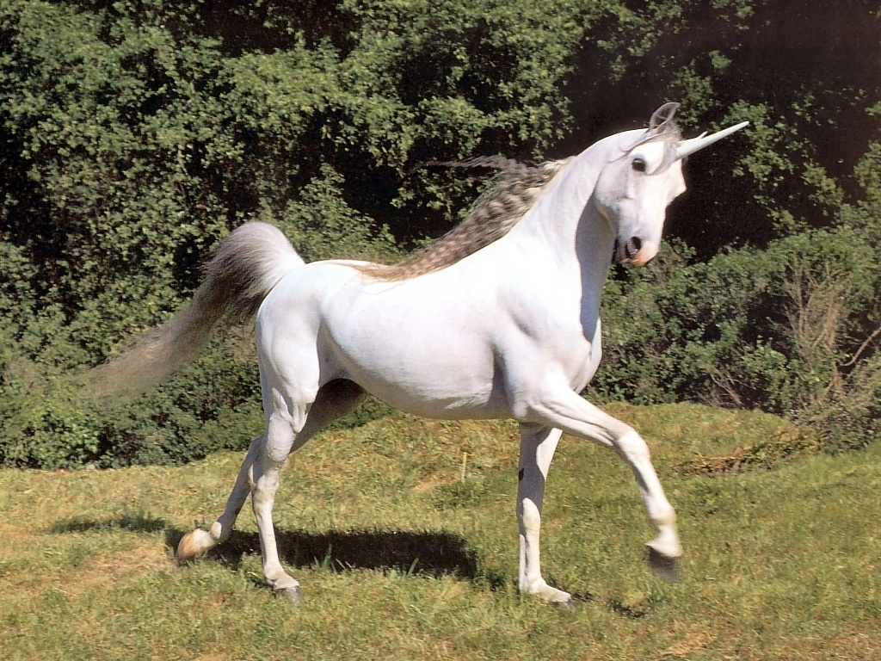
The unicorn is a legendary creature embodied like a horse, but slender and with a single — usually spiral — horn growing out of its forehead. Though the popular image of the unicorn is that of a white horse differing only in the horn, the traditional unicorn has a billy-goat beard, a lion's tail, and cloven hoofs, which distinguish him from a horse. Marianna Mayer has observed, "The unicorn is the only fabulous beast that does not seem to have been conceived out of human fears. In even the earliest references he is fierce yet good, selfless yet solitary, but always mysteriously beautiful. He could be captured only by unfair means, and his single horn was said to neutralize poison."

Slide 3
The first representations of a bull with one horn originate from three
thousand years BC.

Slide 4
Unicorns in Slovenia
In Slovenian tradition, the unicorn is mentioned only in folk songs and in some sermons but not in folktales.

